Slide 1
CEO optimism and incentive compensation
報告人:鄧名勛
指導老師:戴天時

Slide 2
Introduction
Are optimistic CEO paid differently?
Do principals design compensation contracts that take advantage of the agent’s optimism?

Slide 3
We estimate the effect of optimism on compensation plans of CEOs who work for the same firm but in different level of optimism.
Controlling for differences in the employment period and time-varying firm and CEO characteristics.
Asses optimism with two measures:
CEO’s option exercise
& CEO’s earning forecasts

Slide 4
We found out that an unbiased principal will compensate an optimistic agent with fewer incentive claims because the agent tends to overestimate the claim’s future payoff.
Salary
Restricted stock
Stock option
Bonus

Slide 5
Also, we provide an evidence for a negative association between the utilized measures of CEO optimism and the fraction of incentives in the CEO’s total compensation.
If the systematic late exercising of in-the-money options were driven not by optimism but by a higher risk tolerance of the CEOs, then one would expect the opposite result.

Slide 6
Hypotheses and data
An optimism CEO believes good outcomes to be more likely than they really are and thus overestimates the probability of success and the firm’s future prospects.

Slide 7
H1: More optimistic CEOs receive lower incentive compensation.
H2: More optimistic CEOs receive lower total compensation.

Slide 8
LongHolder factor:
Assigning an optimism dummy
=1 , if the options were exercised within one year of their expiration date at at least 40% in-the-money (similar results when using20%&60%).
=0 , o.w.
Weighting these observations by the number of options exercised at that observation.(similar results if weighted by realized profit // equal weight)

Slide 9
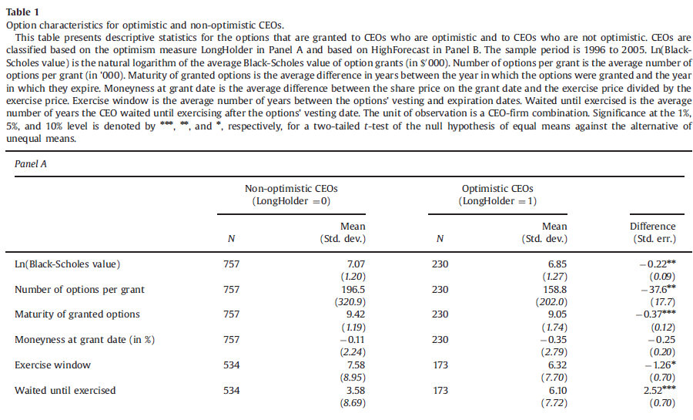

Slide 10
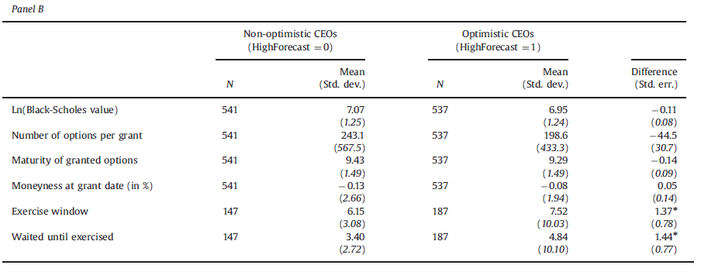

Slide 11
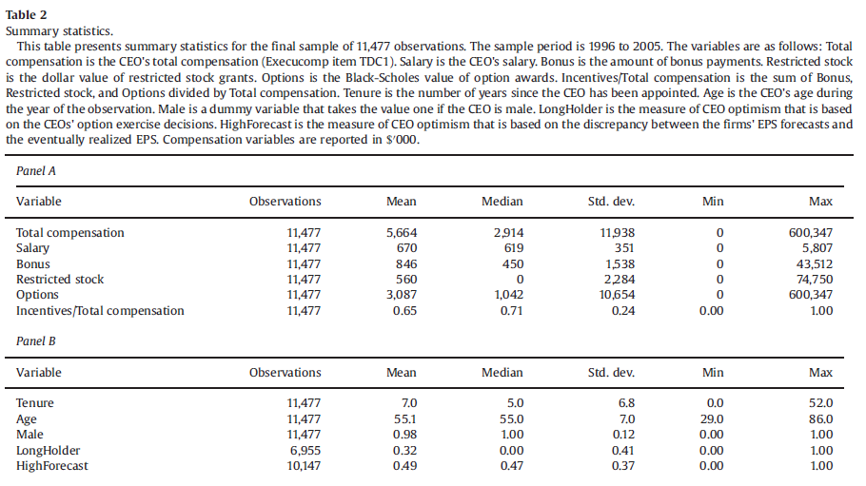

Slide 12
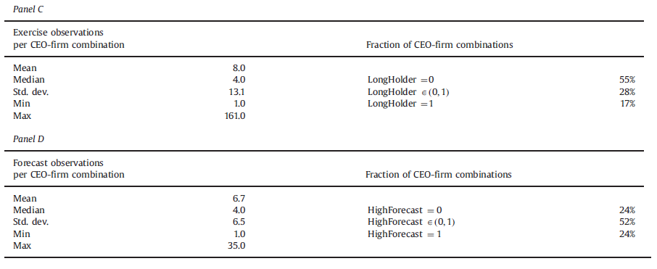

Slide 13

3.2.3 Regression specification
y is the certain CEO compensation.

Slide 14
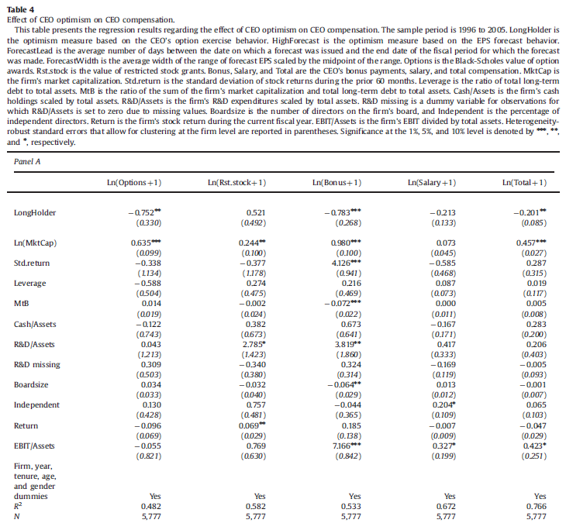

Slide 15
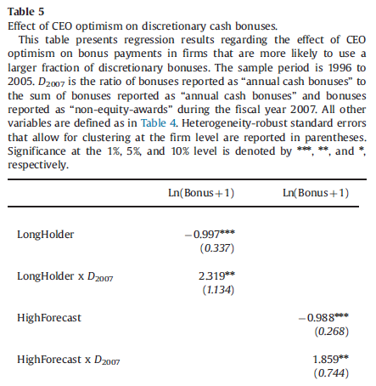
3.2.5 The effect of CEO optimism on discretionary cash bonuses

Slide 16
4.5 Portfolio diversification and risk-tolerance
Including factor ”Ln(CEO invest.)” to capture total value of the CEO’s portfolio of company stock and options at the beginning of the fiscal year. (but has no material effect on the estimation results)

Slide 17
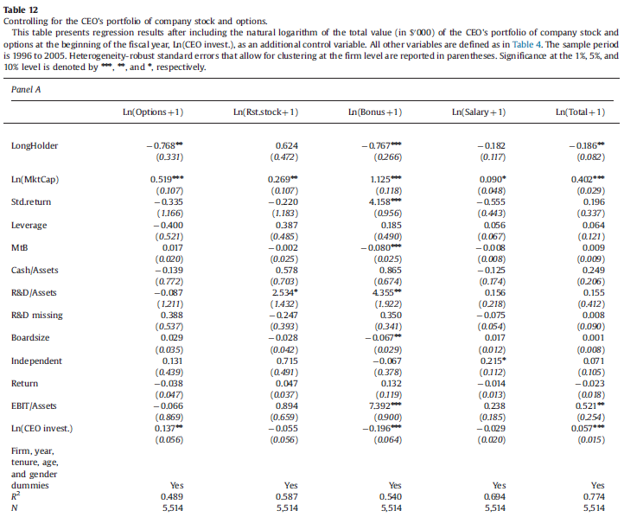

Slide 18
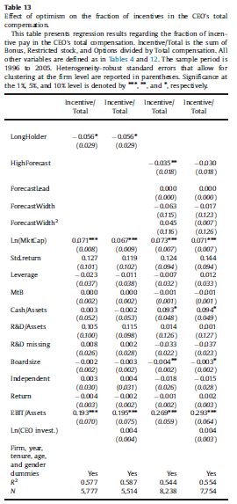

Slide 19
Appendix A
Framework for the effect of optimism on compensation

Slide 20
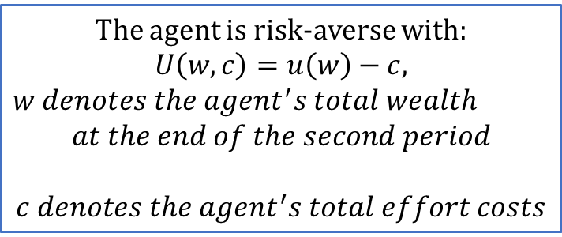
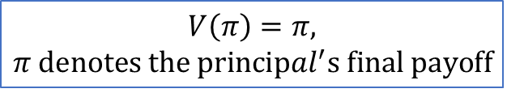
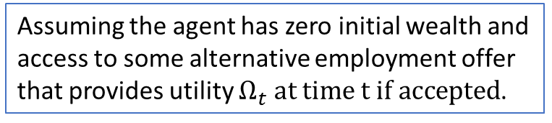
Utility for the agent and the principal
The agent is risk-averse with:
$$U\left(w,c\right)=u\left(w\right)−c,$$
$w denotes the agent^{′}s total wealth$
$$at the end of the second period$$
$$c denotes the agent^{′}s total effort costs$$
Agent
Principal
$$V\left(π\right)=π,$$
$π denotes the {principal}^{′}s final payoff$
Utility function
Assuming the agent has zero initial wealth and access to some alternative employment offer that provides utility $Ω_{t} at time t if accepted$.

Slide 21
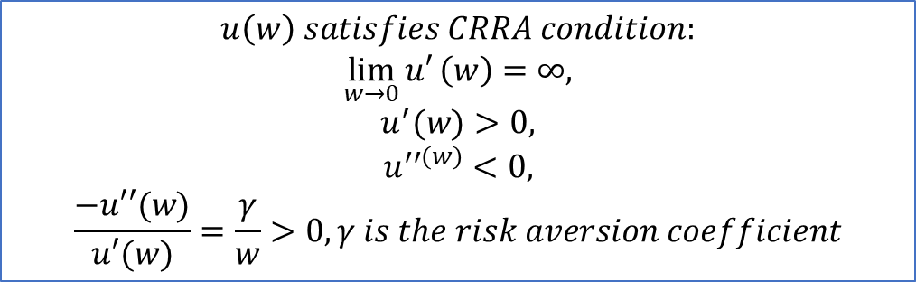
Utility settings of the agent.
$$u\left(w\right) satisfies CRRA condition:$$
$$\lim_{w→0}{u′}\left(w\right)=∞,$$
$$u^{′}(w)>0,$$
$$u^{′′\left(w\right)}<0,$$
$$\frac{−u′′(w)}{u′(w)}=\frac{γ}{w}>0, γ is the risk aversion coefficient$$
$$Assuming the agent has zero wealth at the beginning,$$
$$and access to some alternative employment offer that provides utility Ω_{t} at time t.$$
Assuming the agent has zero initial wealth and access to some alternative employment offer that provides utility $Ω_{t} at time t if accepted$.

Slide 22
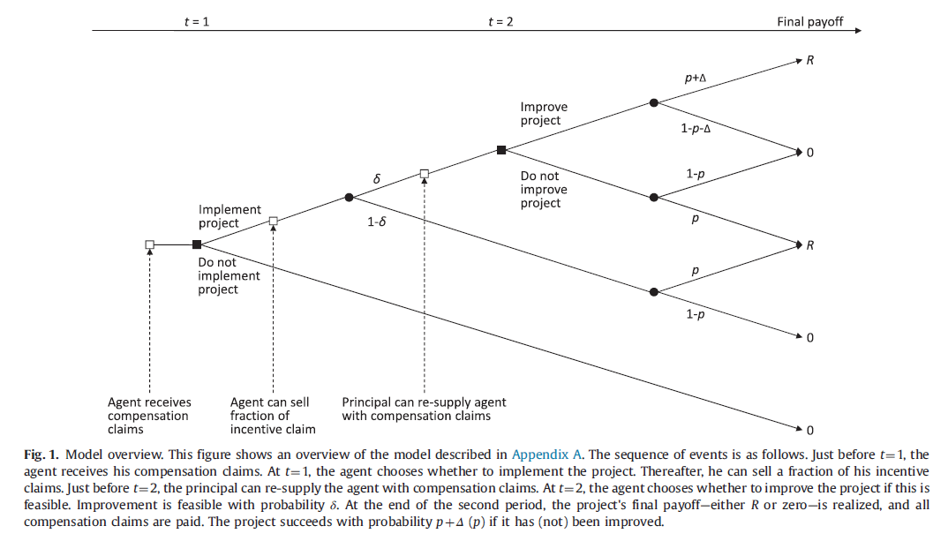
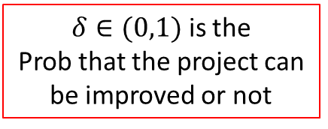
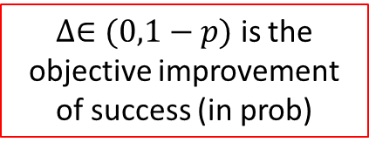
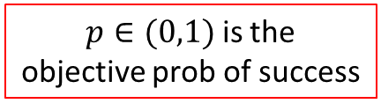
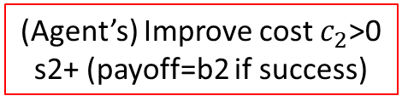
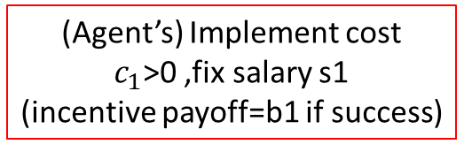
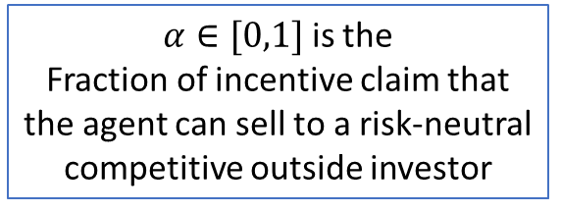
Assume the discount rate=0
(Agent’s) Improve cost $c_{2}$>0 s2+ (payoff=b2 if success)
$∆∈(0,1−p)$ is the
objective improvement of success (in prob)
$δ∈(0,1)$ is the
Prob that the project can be improved or not
(Agent’s) Implement cost $c_{1}$>0 ,fix salary s1
(incentive payoff=b1 if success)
$α∈[0,1]$ is the
Fraction of incentive claim that the agent can sell to a risk-neutral competitive outside investor
$p∈(0,1)$ is the
objective prob of success
Notes:
Assume no cost to the firm

Slide 23
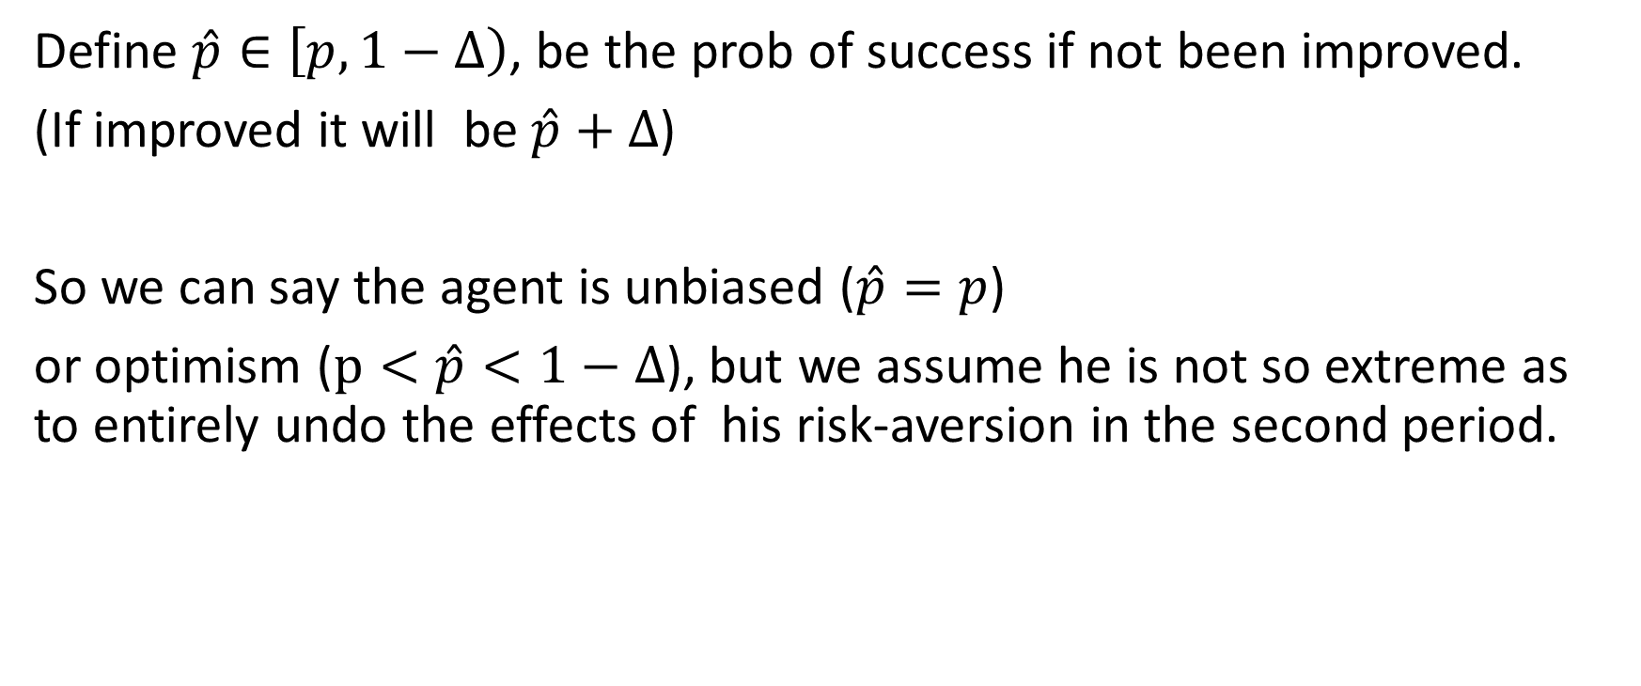
Agent’s probability of success
Define $\hat{p}∈\left[p,1−∆\right)$, be the prob of success if not been improved.
(If improved it will be $\hat{p}+∆$)
So we can say the agent is unbiased ($\hat{p}=p$)
or optimism ($p<\hat{p}<1−∆$), but we assume he is not so extreme as to entirely undo the effects of his risk-aversion in the second period.

Slide 24
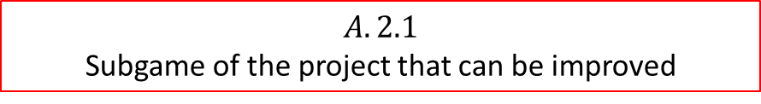
A.2 Derivation of the optimal contract by backward induction
$$A.2.1$$
Subgame of the project that can be improved

Slide 25



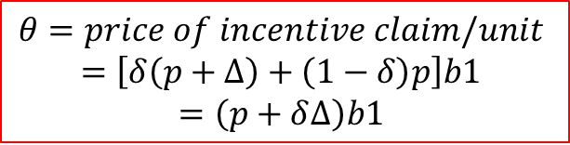







$$θ=price of incentive claim/unit$$
$$=\left[δ\left(p+∆\right)+\left(1−δ\right)p\right]b1$$
$$=\left(p+δ∆\right)b1$$
$$u\left(αθ+s1+\left(1−α\right)\text{b}\text{1}+s2+b2\right)−c1−c2$$
$−$c2
A
s2+$b2$*$1_{success}$
$$u\left(αθ+s1+s2\right)−c1−c2$$
$−$c1
B
$$u\left(αθ+s1+s2\right)−c1(+Ω_{2})$$
$$α∗θ$$
S1+$(1−α)$b1*$1_{success}$
$u\left(αθ+s1+s2+b1+b2\right)−c1(+Ω_{2}$)
$$−0$$
$$−0$$

Slide 26
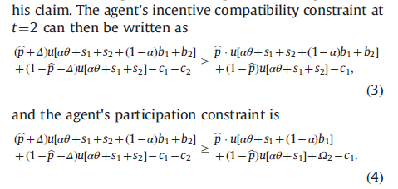
A
B
A
B’

Slide 27
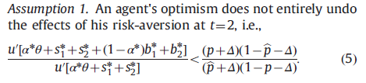
The agent's participation constraint will be binding when evaluated at the optimal contract because the principal is assumed to have all the bargaining power.
Furthermore, it follows from the first-order conditions of the principal's profit maximization problem that the agent's incentive compatibility constraint will be binding at the optimum as long as the following assumption holds:

Slide 28
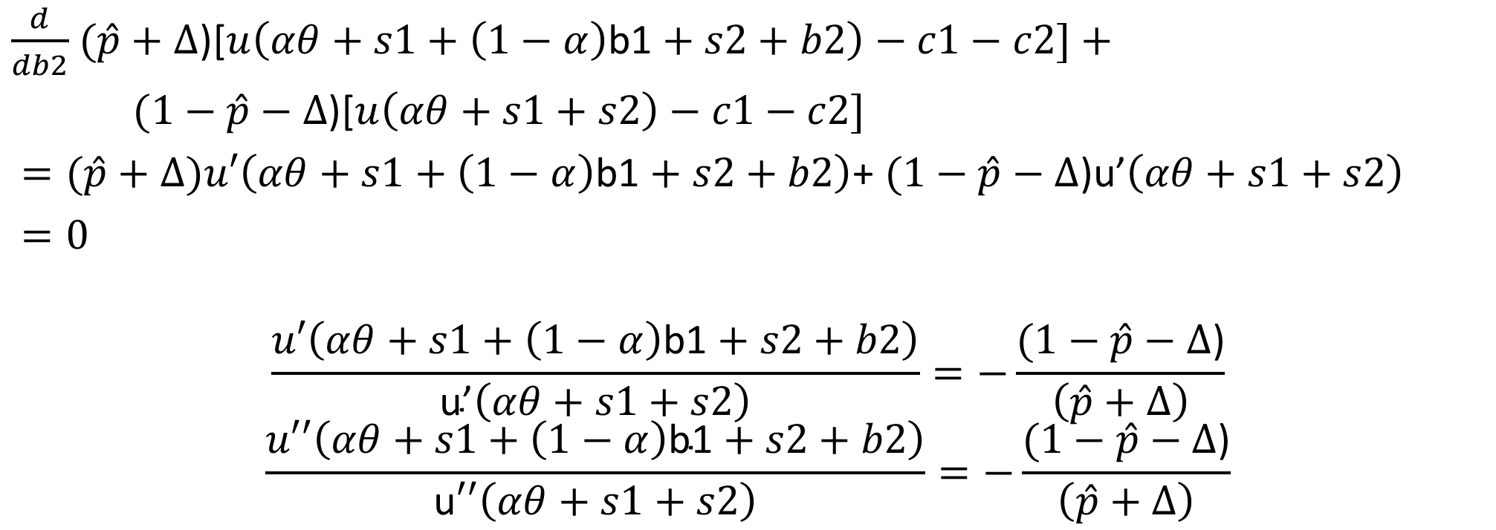
At point A
$\frac{d}{db2}$ $(\hat{p}+∆$)[$u\left(αθ+s1+\left(1−α\right)\text{b}\text{1}+s2+b2\right)−c1−c2]+$
$(1−\hat{p}−∆$)[$u\left(αθ+s1+s2\right)−c1−c2]$
$=(\hat{p}+∆)u′\left(αθ+s1+\left(1−α\right)\text{b}\text{1}+s2+b2\right)$+ $(1−\hat{p}−∆$)u’$\left(αθ+s1+s2\right)$
$=0$
$$\frac{u′\left(αθ+s1+\left(1−α\right)\text{b}\text{1}+s2+b2\right)}{\text{u}\text{’}\left(αθ+s1+s2\right)}=−\frac{(1−\hat{p}−∆\text{)}}{\left(\hat{p}+∆\right)}$$
$$\frac{u′′\left(αθ+s1+\left(1−α\right)\text{b}\text{1}+s2+b2\right)}{\text{u}′′\left(αθ+s1+s2\right)}=−\frac{(1−\hat{p}−∆\text{)}}{\left(\hat{p}+∆\right)}$$

Slide 29


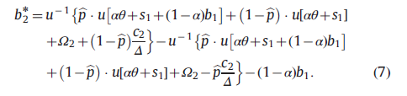

$u\left({αθ+s1+s}_{2}^{∗}\right)=\hat{p}u\left[αθ+s1+\left(1−α\right)b1\right]+\left(1−\hat{p}\right)u\left[αθ+s1\right]+$

Slide 30
